Slide 1

What are the key predictors of Heart disease?
Springboard data science Capstone 3
Prince Zogli, PhD
Mentor: Eleanor Thomas

Slide 2
Final Capstone
Project introduction
Project Background
Data wrangling and EDA
Feature selection and engineering
Model selection and parameters tunning
Recommendations and conclusions

Slide 3
Workflow approach
Problem Identification
Goals
Data Wrangling
EDA
Pre-Processing
Modeling
Tuning
Reporting

Slide 4
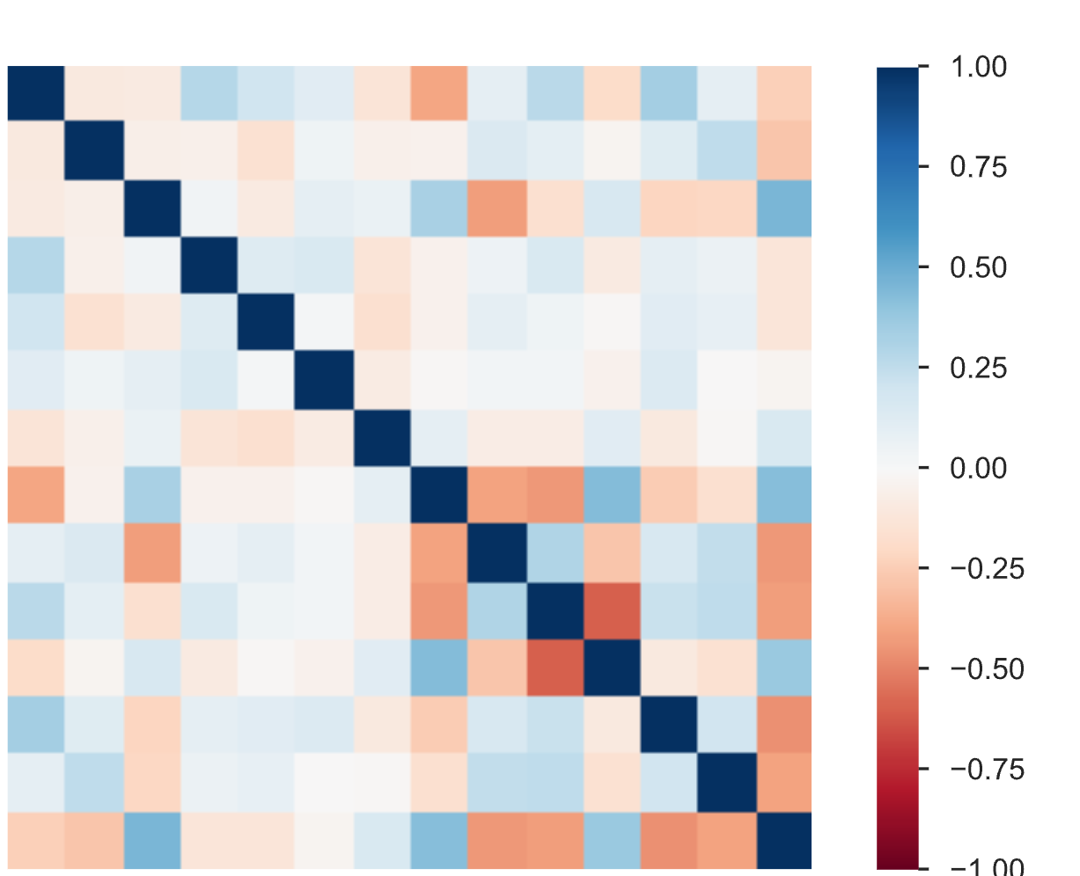
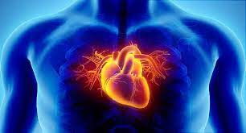
The Problem:
Coronary heart disease(CHD), is one of the leading causes of death in the USA
I am currently a scientist at the Cardiology Center of Bryan hospital in charge of data analysis.
We have seen increased reported cases of cardiac symptoms in our unit
However, it is difficult to identify high risk patients because of the multifactorial nature of contributory risk factors of heart disease.
Our cardiologists collected data from patients and handed it to me to determine risk factors using the data.
I will used Machine Learning(ML) approaches for predicting risk for CHD disease.

Slide 5

Our Goal

Slide 6
Our Goals
Build a model to predict whether a patient should be diagnosed with Heart Disease(Binary)
    Positive (+) = 1, patient diagnosed with Heart Disease
    Negative (-) = 0, patient not diagnosed with Heart Disease
Examine trends & correlations within our data
Determine which features are most important to Positive/Negative Heart Disease diagnosis
Build classification Models & see which yields greatest accuracy.

Slide 7
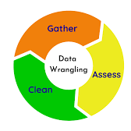
Data Wrangling

Slide 8
Data and features
1. age (C)
2. sex : 1= Male, 0= Female (Bi)
3. (cp)chest pain type (4 values -O):Value 1: typical angina ,Value 2: atypical angina, Value 3: non-anginal pain , Value 4: asymptomatic
4. (trestbps) resting blood pressure (C)
5. (chol) serum cholesterol in mg/dl (C)
6. (fbs)fasting blood sugar > 120 mg/dl(Bi)(1 = true; 0 = false)
7. (restecg) resting electrocardiography results(C 0,1,2)
8. (thalach) maximum heart rate achieved (C)
9. (exang) exercise induced angina (Bi) (1 = yes; 0 = no)
10. (oldpeak) = ST depression induced by exercise relative to rest (C)
11. (slope) of the peak exercise ST segment (O) (Value 1: up sloping , Value 2: flat , Value 3: down sloping )
12. (ca) number of major vessels (0–3, O) colored by fluoroscopy
13. (thal) maximum heart rate achieved — (O): 3 = normal; 6 = fixed defect; 7 = reversible defect
There are 3 data types:
Continuous (C): which is quantitative data that can be measured
Ordinal Data(O): Categorical data that has a order to it (0,1,2,3,)
Binary Data(Bi): data whose unit can take on only two possible states ( 0 &1 )

Slide 9
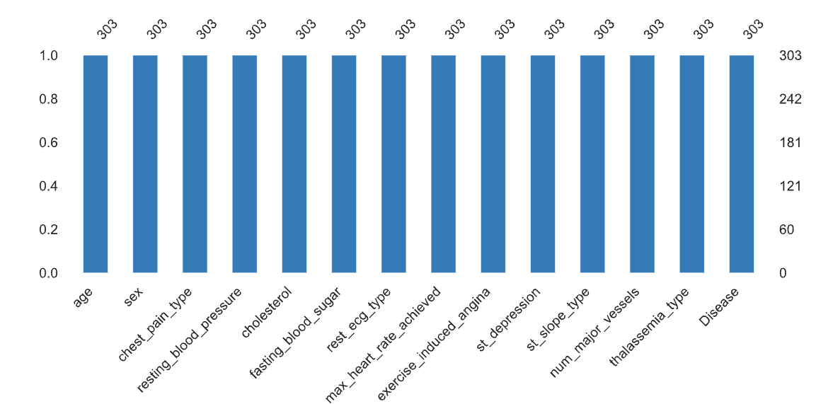
Data wrangling summary
To check the data the following were done:
  There are 303 entries and 14 columns/features in total.
  Disease our target/dependent variable will be modeled by 13 features
  There are no missing values

Slide 10

Exploratory Data Analysis
EDA

Slide 11
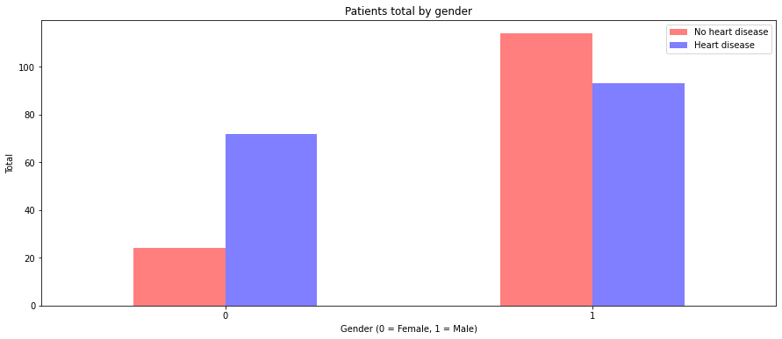
Males are more likely to have Heart disease
than females
There are 165 patients with heart disease compared to 138 healthy patients

Slide 12
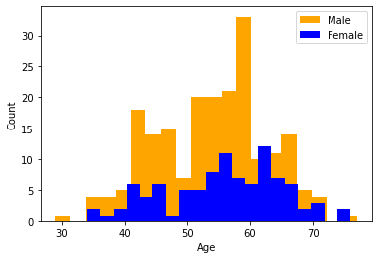
But this is likely due higher representation of men compared to women
There are twice men as there are women

Slide 13
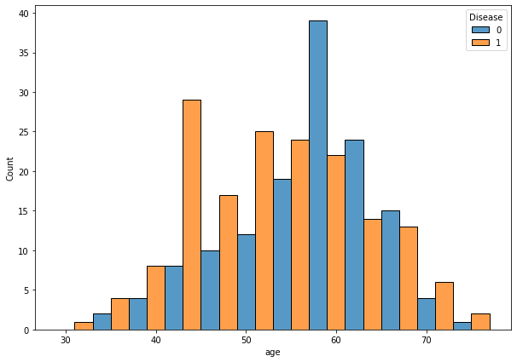
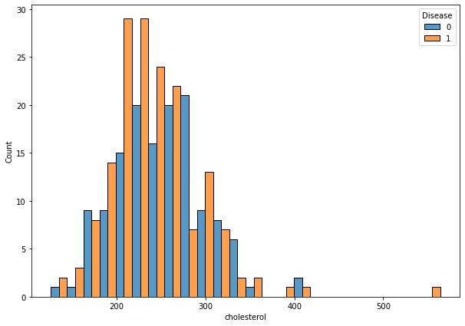
Age and Cholesterol risk factors
Disease : Positive= 1, Negative= 0
All Age groups stand a risk ,but High Cholesterol seem a factor the compounds the risk, we will see from the modelling if this is true

Slide 14
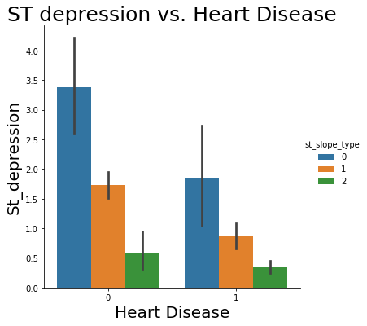
Does St Segment paint any picture
Low ST Depression yields people at greater risk for heart
However, there is even distribution of the 3 slope categories(0=0: upsloping , 1: flat , 2: downsloping).

Slide 15
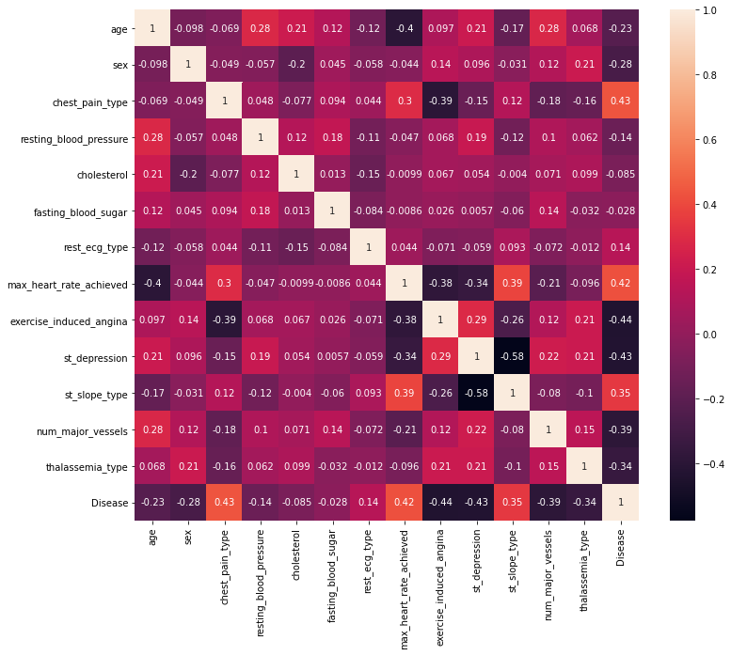
Correlation float features
There is between 30-43% correlation between risk of disease and Chest pain, heart rate, st_depression, agina and thalassemia.
Predictive features such as Age & blood pressure, Chest pain & heart rate among others have some degree of correlation

Slide 16
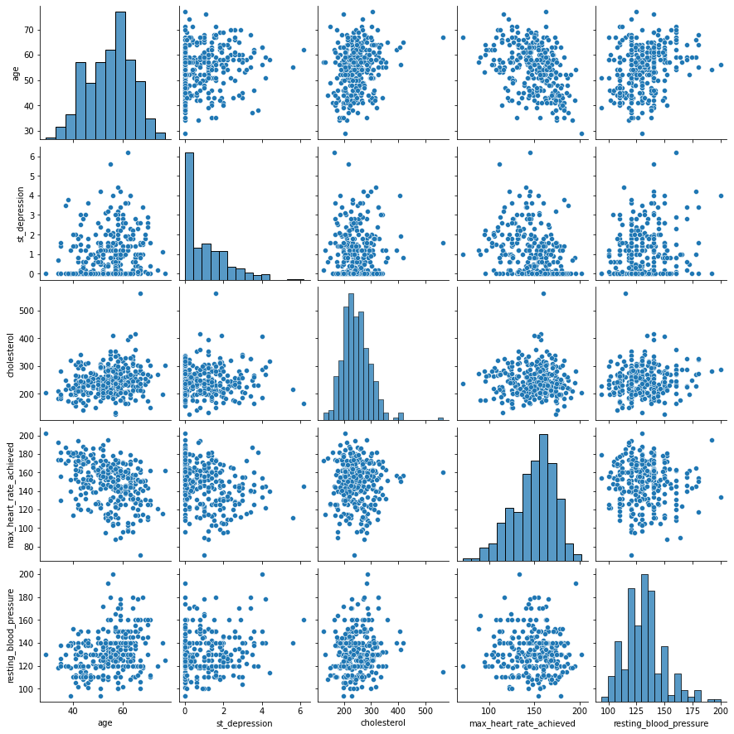
Correlation among float features
Will the correlation among predictive features be a problem?

Slide 17
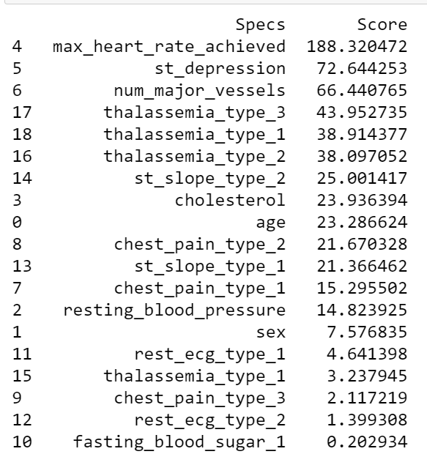
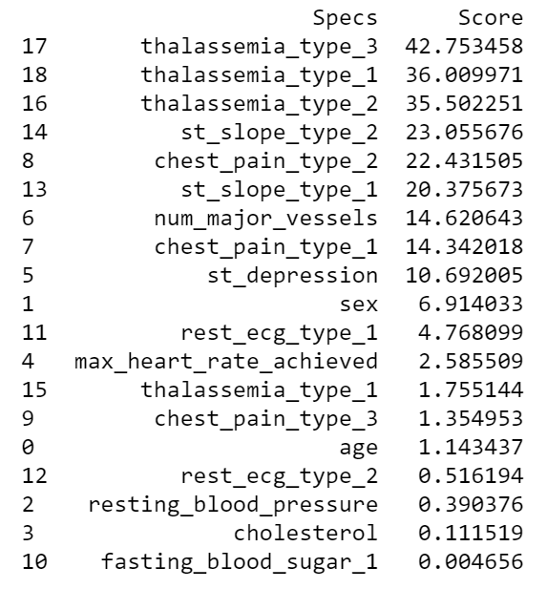
Pre-procession and feature selection
Raw data Normalized data
Fasting blood sugar, cholesterol and resting blood sugar may not give much to the model

Slide 18
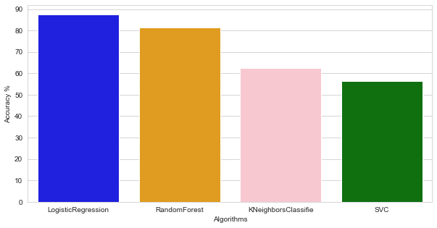
Models Result
Logistics Regression gave the best accuracy on test data

Slide 19
Conclusion and future directions
Logistics Regression was the best performing model
Features including thalassemia, heart rate and St-Slope a top predictors of heart disease
Models to be rebuilt by removing less important features

Slide 20
Questions?
Thank you

